Slide 1
SU² code structure
Introduction to the SU² Code Structure
July 1st, 2014
Francisco Palacios, Michael Colonno,
Thomas D. Economon, Juan J. Alonso
Department of Aeronautics & Astronautics
Stanford University

Slide 2

Code structure SU² C++ Modules
SU2_CFD - Main CFD solver
SU2_PRT - Mesh Partitioning Code
SU2_SOL - Solution Export Code
SU2_MSH - Mesh Adaptation Code
SU2_DEF- Mesh Deformation Code
SU2_GEO - Geometry Definition Code
+ Python scripts
+ SU2_EDU (Educational version)
+ SU2_PHI (Xeon Phi version, on going Intel® collaboration)
Notes:
This is a high level view of the code, once you get a copy of SU2 on your local computer and you look into the trunk directory, you will see these directories (in addition to a few others). These directories have the source code and I will quickly glance over what each one of these does.
SU2_CFD is the main module that solves the partial differential equations.
SU2_DDC is used when you want to run a solution on multiple processors, it breaks the mesh for each processor.
SU2_MAC is the mesh adaptation code, used to dynamically refine meshes for better accuracy while a flow solution is in progress.
SU2_MDC is the mesh deformation code used to deform meshes while a flow solution is in progress.
SU2_PBC is a preprocessor used when you have periodic boundary conditions, it creates halo cells around periodic boundaries.
Then, you have SU2_SMC which is called when you have sliding meshes.
In this talk, we are going to focus on the main module, which is SU2_CFD.

Slide 3
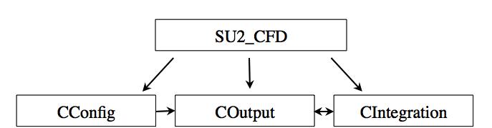
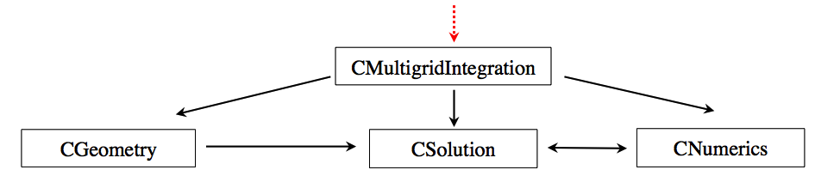
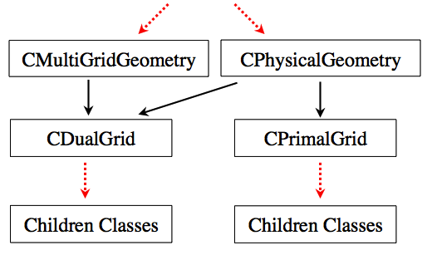
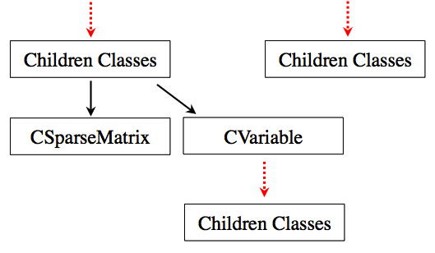
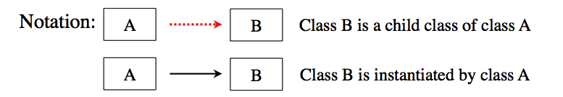
Code structure Class hierarchy in SU2_CFD
Internal structure for storing and solving linear systems:
CSysVector, CSysMatrix
CSolver

Slide 4
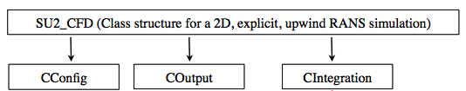
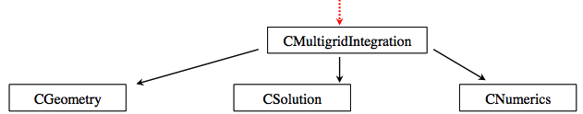

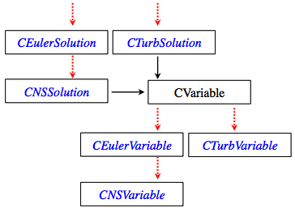
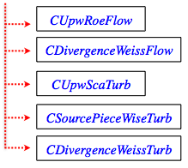
Code structure Class hierarchy for solving a RANS problem
Internal structure for storing and solving linear systems:
CSysVector, CSysMatrix
CSolver
Solver
Solver
Solver

Slide 5
Code structure Class hierarchy in SU2_CFD
1a) Read Input
Class: CConfig
Read the config file.
1b) Read Mesh
Class: CGeometry
Read the mesh file.
Set up multigrid meshes.
2) Solve Equations
Class: CSolver
Euler Equations: CEulerSolver
Plasma Equations: CPlasmaSolver
Euler Adj. Eq.: CEulerAdjSolver
Heat Equations: CHeatSolver
And others…
3) Write Output
Class: COutput
Print on screen
Write solution file
Write restart file
Write history file
Store Flow Variables
Class: CVariable
Stores variables at every mesh node.
Declare & store all flow variables
CEulerVariable: Density, energy etc.
CNSVariable: CEulerVariable + Viscosity
CAdjVariable: Adjoint variables
And others…
Discretization
Class: CNumerics
Spatial Discretization
Convective Flux, Jacobian
CNumerics:: Roe/JST/etc.
Viscous Flux, Jacobian
CNumerics:: Avg_Grad/etc.
Source Terms, Jacobian
CNumerics:: PieceWiseConst.
Temporal Discretization
Implicit Time Integration
Explicit Euler/ Runge-Kutta
Dual Time
Solve Linear System
Class: CSparseMatrix
Linear solvers
BiCSTAB
GMRES
Preconditioners
Linelet
LU-SGS
Low Mach number
Update solution vector
Notes:
SU2_CFD does three things, mainly, it reads the input configuration file and the mesh file. It solves the governing equations and then it outputs the solution in a file.
Now let’s look at each of these in a little bit detail, before I begin, let me mention that SU2 names every class starting with a C followed by what it does.
So, Cconfig is a class for reading and storing the configuration specs, Cgeometry is to read and store the geometry. we will start with the input. If one is using multigrid to accelerate convergence by using multiple meshes with different degree of coarseness, then Cgeometry creates different meshes inside the code, which are used by the solver. You can output these meshes too if you want to look at them.
Then, let’s go to the Output class, Coutput, which is used to print the residuals on the screen, write the converged solution to files in tecplot/paraview format and other things.
These two classes are defined in the Common directory, because they are used by the other modules too.
Next, l

Slide 6
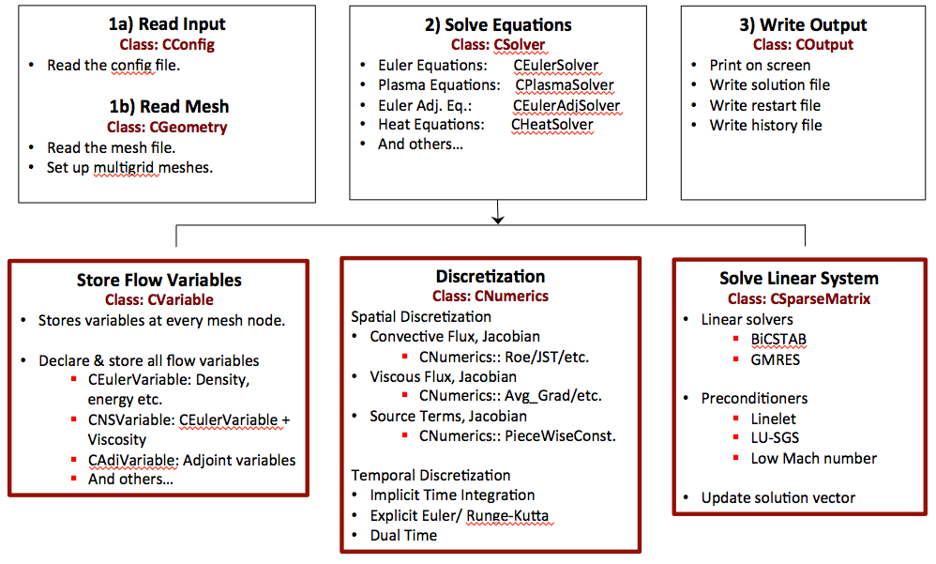
Code structure CGeometry Class
CGeometry
CPhysicalGeometry
CMultiGridGeometry
CPrimalGrid
CDualGrid
Children Classes
Children Classes
Parent Class: CPrimalGrid
Parent Class: CDualGrid
Files in Common/include:
geometry_structure.hpp
geometry_structure.inl
In Common/src
geometry_structure.cpp
CHexahedron
CEdge
CLine
CPoint
CPyramid
CVertex
CRectangle
CTetrahedron

Slide 7
Code structure CSolver Class
Parent Class: CSolver
CSolution
CEulerSolver
CNSSolver
CTurbSolver
CTurbSASolver
CEulerSolution
CPlasmaSolver
CTurbSSTSolver
CWaveSolver
CVariable
CNumerics
CSparseMatrix
CFEASolver
CHeatSolver
CEulerVariable
CRoe_Flow
CLevelSetSolver
CAdjEulerSolver
CAdjNSSolver
Files in SU2_CFD/include:
solver_structure.hpp
solver_structure.inl
In SU2_CFD/src
solver_direct_mean.cpp
solver_adjoint_mean.cpp
solver_direct_template.cpp
etc.
CAdjTurbSolver
CAdjPlasmaSolver
CAdjLevelSetSolver
CLinEulerSolver
CTemplateSolver

Slide 8
Code structure CVariable Class
Parent Class: CVariable
CEulerVariable
CNSVariable
Stores variables for a particular solution class, at EVERY grid node.
CTurbVariable
CTurbSAVariable
CPlasmaVariable
CTurbSSTVariable
CWaveVariable
CFEAVariable
CHeatVariable
CLevelSetVariable
CAdjEulerVariable
CAdjNSVariable
Files in SU2_CFD/include
variable_structure.hpp
variable_structure.inl
SU2_CFD/src
variable_direct.cpp
variable_adjoint.cpp
variable_template.cpp
etc.
CAdjTurbVariable
CAdjPlasmaVariable
CAdjLevelSetVariable
CLinEulerVariable
CTemplateVariable

Slide 9
Code structure CNumerics Class
Child Classes for:
Convective Flux Discretization + Jacobian
Viscous Flux Discretization + Jacobian
Source Terms Discretization + Jacobian
Files in SU2_CFD/include
numerics_structure.hpp
numerics_structure.inl
In SU2_CFD/src:
numerics_structure.cpp
numerics_convective.cpp
numerics_viscous.cpp
numerics_source.cpp

Slide 10
Code structure CNumerics Class
Parent Class: CNumerics
Roe Scheme
Average Gradient
Piecewise Constant Source
JST Scheme
Galerkin
Plasma Source
AUSM Scheme
Average Gradient Corrected
Gravity Source
HLLC Scheme
Template Viscous Terms
Electrical Source
Steger-Warming Scheme
Turbulence Source
Roe-Turkel for low Mach
Transition Source
Lax-Friedrich Scheme
Upwinding for Turb Scalar
Axisymmetric Source
Template Convective Terms
Rotating Frame Source
Free Surface Source
Template Source Terms

Slide 11
Thanks a lot for your attention!
Questions & Answers
More details in http://su2.stanford.edu/

